Slide 1
MidSouth Region USPC
Keys to Success – Ideas for planning Meetings
Compiled by Becky Logsdon, RS November 21, 2016

Slide 2
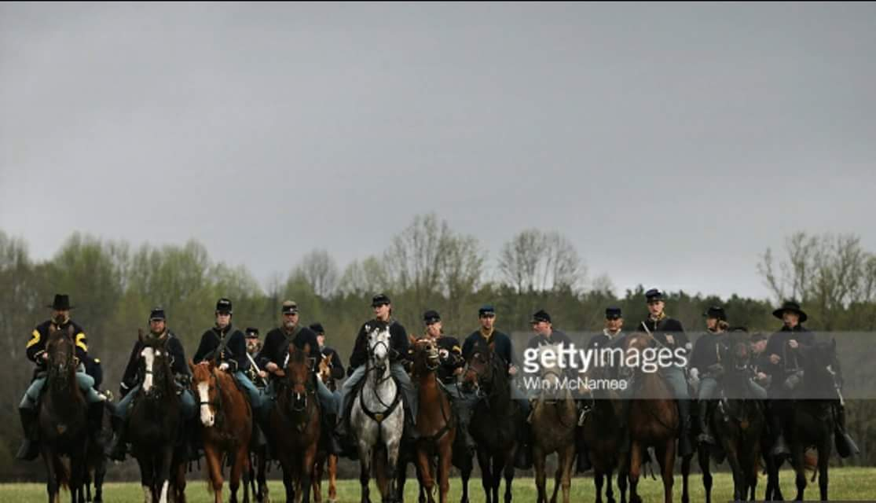
MidSouth Region USPC Don’t just stand around and wonder where to get lesson ideas….

Slide 3
MidSouth Region USPC
It can sometimes seem like a daunting task to find ideas for unmounted and mounted meetings, but it doesn’t have to be. There are many resources available, and we’d like to take this opportunity to share some of them with you.
First, go to the main source: www.ponyclub.org

Slide 4
MidSouth Region USPC
Once you sign in, scroll across the top and select “INSTRUCTORS” and the drop down menu shows a list that includes:
Horse Management
Mounted
Discipline
These plans are set up according to certification level, too!

Slide 5
MidSouth Region USPC
Horse Management lesson plans include:
Bandaging – 4
Conditioning- 1
Foot & Shoeing - 6
Health Care & Veterinary Knowledge – 5
Horse Sports – 3
Land Conservation – 5
Leading & Longeing – 6
Nutrition - 7
Breeds ,Parts of Mount, Conformation & Lameness – 6
Record Book – 2
Stable Management – 13
Teaching – 1
Travel Safety – 4
Turnout, Tack - 13

Slide 6
MidSouth Region USPC
Mounted Lesson Plans include:
Warm-up – 5
Position and Control – 7
Movements – 7
Safety & Etiquette – 4
Jumping, Obstacles, Patterns & Tests – 5
In the Open – none yet…do you have a good plan to submit?

Slide 7
MidSouth Region USPC
Discipline Lesson Plans:
Dressage has 21
Eventing has 21
Polocrosse has 24
Quiz – refer to the rulebook – lots of ideas there
Show Jumping has 2
Tetrathlon has 3 documents with information and FAQs about the sport, especially shooting
Western – none yet. Do you have any that you’ve used?
Distance Riding – none yet
Driving – none yet
Foxhunting has 10
Polo has none listed yet
Vaulting refers to the rulebook, which is almost entirely lesson plans

Slide 8
MidSouth Region USPC Pony Club IQ
Pony Club IQ
For over 60 years The United States Pony Clubs, Inc. has been leading the way in horse care and horse management skills. Members of all ages are constantly learning from alumni, instructors, and other professionals in the horse industry. We are so pleased to be able to offer our members unlimited access to a vast array of articles and knowledge from TheHorse.com.
Articles from TheHorse.com have been organized by Pony Club certification levels and placed into categories based on the Standards of Proficiency to help you learn and advance your horse management comprehension at a pace that is comfortable for you.
The D levels are an introduction to establishing safety habits and knowledge of the daily care of a horse and related equipment.
The C levels begin to create an independent horseman able to care for a mount and related equipment.
The H-B level covers horse management topics that demonstrate increasing knowledge and competence in the care and handling of horses.
The H-A level covers horse management teaching and training with knowledge and experience to evaluate and care for a mount's needs efficiently and in a variety of circumstances.

Slide 9
MidSouth Region USPC Pony Club IQ
D Level (D-1, D-2, D-3)
A D-1 is a beginning-level horse manager, willing to learn the routine necessary for safe handling of quiet, well trained horses. His or her knowledge will vary widely depending on age, educational level, and experience. A D-2 should be able to demonstrate skills, with assistance if necessary, and should understand the basic reasons for the everyday routines of caring for his or her own mount. A D-3 should be able to demonstrate skills without assistance, and to discuss care of the mount, using common horse terms.
The articles found in the categories below contain appropriate information to assist a Pony Club member’s advancement through the D level certifications. Articles are written in a manner that can be understood by the novice horse person as they begin their quest for knowledge.
Bandaging
Conditioning
Conformation & Lameness
Foot & Shoeing
Health Care & Veterinary Knowledge
Nutrition
Record Book
Stable Management
Travel Safety
General Interest

Slide 10
MidSouth Region USPC Pony Club IQ
C Level (C-1, C-2)
A C-1 shows a developing awareness of cause and effect in the care of one’s own mount and is familiar with local common horse terms. A C-2 shows a solid awareness of cause and effect in horse management skills.
Articles in this category are meant to continue the education of the Pony Club member. These articles show more in-depth descriptions of horse management skills needed to obtain certification throughout the C- levels.
Bandaging
Conditioning
Conformation & Lameness
Foot & Shoeing
Health Care & Veterinary Knowledge
Nutrition
Record Book
Stable Management
Travel Safety
General Interest

Slide 11
MidSouth Region USPC Pony Club IQ
H-B Level
At the H-B level, an individual should be competent while demonstrating sound judgment and maturity in the continuing care of their mounts and equipment. They understand reasons for their decisions, knowing when to seek assistance, if necessary. They show knowledge of veterinary care.
Articles in this category help the upper level candidate with their reasoning explanations. Research and current veterinary knowledge is shared to help members with discussions about specific common ailments as well as increased awareness of the care of horses and equine facilities.
Condition
Conformation and Lameness
Foot & Shoeing
Nutrition
Record Book and Veterinary Care
Stable Management
Tack
Travel Safety
General Interest

Slide 12
MidSouth Region USPC Pony Club IQ
H-HM/H/H-A Level
At this level, an individual has a sound knowledge of horses, their care, equipment, and training requirements including longeing. They must have comprehensive stable management knowledge, and demonstrate the ability to make informed decisions about all aspects of running a barn, including daily routine, feeding programs, conditioning, care and emergency procedures.
Articles in this category are meant to help members at the highest levels of Pony Club to achieve the knowledge they need to be successful in any equine position. These articles will target specific areas of the Standards of Proficiency to give members in-depth information regarding all areas of horse care and management.
Bandaging
Conformation and Lameness
Diseases
Health
Nutrition
Special Care
Stable/Farm Design and Management Plan
Systems
General Interest

Slide 13
MidSouth Region USPC Tutoring Tuesdays!
Tutoring Tuesday Webinars!
Welcome to the Pony Club Tutoring Tuesday Webinar series. USPC Webinars are typically scheduled on Tuesday nights at 8pm Eastern Time. Webinars are open to everyone. They can be watched live when they are presented, or later at a time most convenient to you. They can be viewed on a computer or on most mobile devices. USPC webinars run for around one hour and questions can be asked on the topics via the questions field. A wide range of topics are covered including:
Horse Care and Stable Management
Travel Safety
USPC Certifications
Leadership Training
How-to tips for success
If there is a topic you would like to see, USPC always welcomes new ideas. Better yet, if you have an interest in presenting a topic and would like to be considered as a webinar presenter please contact us.
Another great thing about Tutoring Tuesday Webinars is that if you can’t listen in on the live session, they are all recorded and can be viewed at your convenience!!

Slide 14
MidSouth Region USPC Tutoring Tuesdays
Tutoring Tuesday continued…
48 webinars available as of today with topics ranging from “What is Horse Management” to how to integrate HorseMasters in to your club or center! Audio and slides…
Tutoring Tuesdays are sponsored by Merck Animal Health

Slide 15
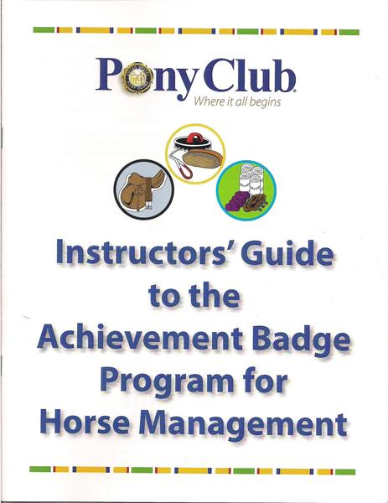
MidSouth Region USPC The Badge Program!!
Great and fun way to teach young members!
Everything you need is available through Shop Pony Club

Slide 16
MidSouth Region USPC The Badge Program!!
Achievement Badge Program for Horse Management Workbook
$8.00 from Shop Pony Club
This booklet outlines the objectives for each badge and provides guidance on what knowledge will be needed to achieve each badge. Includes lessons for badges on
Grooming, Feeding, Horse Parts, Tack, Health Care, Shoeing, Boots and Bandages, Leading, Turnout/Attire, Stable Management and the five new badges Land Conservation, Breeds, Conformation, Conditioning and Travel Safety.

Slide 17
MidSouth Region USPC The Badge Program!!
Achievement Badge Program for Riding Workbook
$8.00
This useful workbook offers an Objective and exercises for each of the ten Riding Badges. Some safety tips, drawings, and do's and don'ts are included.

Slide 18
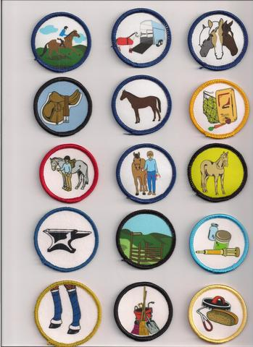
MidSouth Region USPC The Badge Program!!

Slide 19
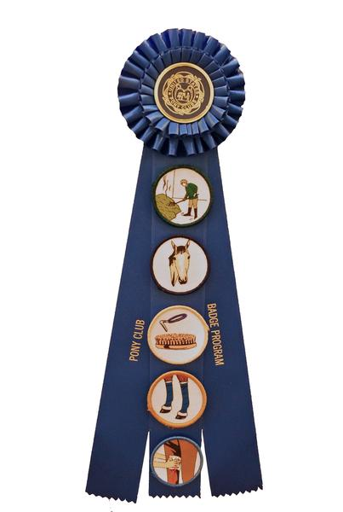
MidSouth Region USPC The Badge Program!!

Slide 20
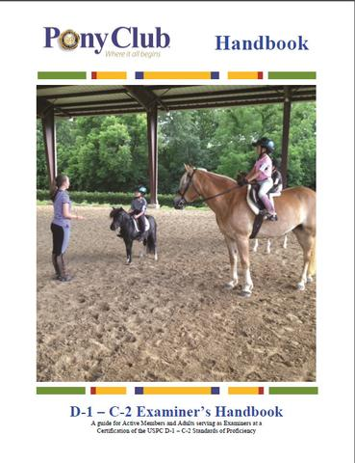
MidSouth Region USPC Handbooks!

Slide 21
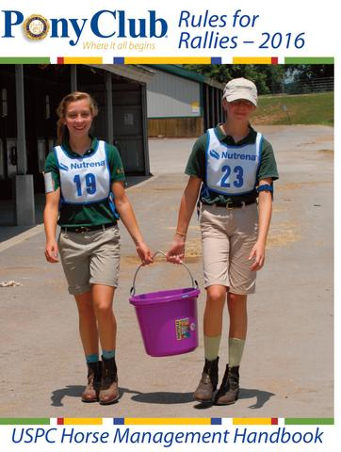
MidSouth Region USPC Handbooks!
The most important rulebook – consider making it required reading for all new members and parents because it is the core of the program!

Slide 22
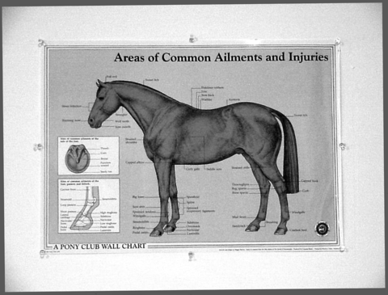
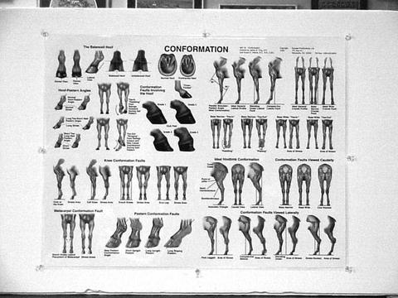
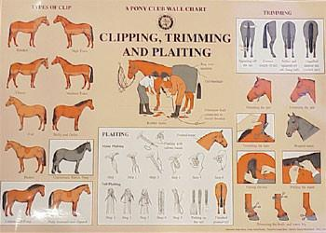
MidSouth Region USPC Charts!
These and many more are available at Shop Pony Club…

Slide 23
MidSouth Region USPC Pony Club Pizza! Where we pile on the knowledge!
Access through www.ponyclub.org
Click on News, then drop down to Pony Club Pizza - Blog… here is the current list of “toppings”
Pony Club Pizza Toppings
"Say What?" Quiz (17) Alumni in the News (18)
Annual Meetings (19) Dressage (20)
Eventing (41) Foxhunting (16)
From the Parents (9) IRide! – Pony Club Discipline News (45)
In The Spotlight (54) Lesson Plans (9)
National Youth Board (24) Play Games (14)
Polocrosse (13) Pony Club Love (74)
Show Jumping (18) Slices of Life (42)
Special Events (48) Tetrathlon (12)
Tips From Pony Club Pros (43) Western (7)

Slide 24
MidSouth Region USPC FESTIVAL!!
The week-long Pony Club Festival is held every three years at the Kentucky Horse Park in Lexington, KY. More than 3,000 Pony Club members, volunteers, and families participate in this special event. The National Championships are held the first three days. Two more days follow with mounted and unmounted clinics and workshops taught by Pony Club graduates, Olympians, and equine industry professionals. Throughout the week, participants, family, and visitors can shop at the Festival Trade Fair, participate in and watch the Mock Fox Hunt, and enjoy all aspects of Pony Club activities!
To participate in Festival Mounted Clinics a member must be 10 years of age and a minimum of D-3 Flat Certification. Pony Club members of any age or certification may register for the Unmounted Workshops (however, at least 8 years old is recommended). Participants will have unlimited access to all unmounted workshops and to audit any mounted clinics. Also available will be D-Camp for Pony Club members who are 6 years old or older and are untested or a D-1 (limited space).

Slide 25
MidSouth Region USPC Other sources…
USDF – United States Dressage Federation at www.usdf.org
This is a membership organization, but there are things you can access without being a member. Click on the USDF Member Guide under publications, and all of the dressage tests are printed there.
You can also find the USDF on Facebook!
USEA – United States Eventing Association at www.useventing.com
They always have lots of articles to click on and read, without having to be a member. It is an excellent resource for information.
You can also find the USEA on Facebook!

Slide 26
MidSouth Region USPC Other sources…
American Association of Equine Practitioners
www.aaep.org
There is a wealth of information available from this website. Take some time to check it out! There are webinars; Ask-A-Vet; and published guidelines.

Slide 27
MidSouth Region USPC The Horse!
One of my personal favorite sources is The Horse
www.thehorse.com
Check it out – there is a newsletter, webinars, and pertinent articles.
Some of the contributing authors are USPC-affiliated professionals. Clair Thunes, the RS from the Sierra Pacific Region, is a frequent contributor for articles about nutrition.

Slide 28
MidSouth Region USPC Unmounted Fun
Inland Empire Region’s “Unmounted Fun”
If you are affiliated with an older club or center, check the “library” to see if you have a copy of Unmounted Fun, which was published by the Inland Empire Region as a fundraiser back in January, 2001. Unfortunately it is out of print now, so if you have a copy – KEEP IT!
It is a source of dozens of lesson plans, suitable for members from beginners through upper levels. You may have to revise somewhat, but the base is still relevant, and appropriate.

Slide 29
MidSouth Region USPC Ask you friends..
And last (for now …)
Ask your friends for ideas, other clubs and centers, other regions, ask a question on the DC Digest, or the CA Digest, ask your regional RIC, ask your regional HMO…just ASK and then

Slide 30
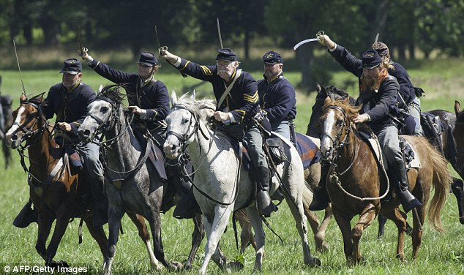
MidSouth Region USPC Now that you have some ideas..CHARGE!

